Slide 1
Input/Output in Raspberry Pi
Based on
https://thinkingeek.com/2014/05/24/arm-assembler-raspberry-pi-chapter-19/

Slide 2
Introduction
Thus far, you have accessed the registers and the memory in a Raspberry Pi. But you have not accessed the keyboard or the screen. All devices external to the CPU and memory must be accessed via system calls.

Slide 3
System Calls
A program interacts with the operating system by performing system calls. A system call is like calling a subroutine but more dangerous. It gives access to the internal operations of the operating system. Use system calls carefully, as you can mess things up very easily.

Slide 4
System calls (cont.)
The ARM instruction for making a sytem call is svc. It takes a 24-bit operand that could be used by the the operating system to tell which service has been requested. Linux, however, ignores the operand and checks the value in R7 instead to determine the requested service. Traditionally, a zero is used as the operand, but this is not mandatory. What is mandatory is that there must be an operand.

Slide 5
Common System Calls
While there are over 300 system calls available in Linux, here are the three you will use most often:
exit - (code #1) normal program termination
read - (code #3) input a line of text
write - (code #4) write a line of text
The numeric code is placed in r7.

Slide 6
Documentation of System Calls
Each system call corresponds to a Linux command. Thus, you can find documentation about each system call by consulting the info page about each command. For example,
info exit
will tell you the parameters and return value of the exit system call.

Slide 7
File Descriptors
For both read and write, the first parameter, placed in r0, is the file descriptor, which is a numeric code to identify the device. To read from the keyboard, you use file descriptor 0. To write to the screen, you use file descriptor 1. It is possible to open files on the SD card and assign them file descriptor numbers, but this is beyond the scope of this presentation.

Slide 8
Address of string
The second parameter, stored in r1, of both read and write is the address of the string either to be read or written. Usually this will be specified by a label, as you will have no way of knowing where in memory your program will be loaded. ARM has no LEA instruction. Instead, we use a variation of the LDR instruction:
ldr r1, =label
This instruction gets the address the label corresponds to.

Slide 9
Maximum Character Count
The third parameter, stored in r2, is the maximum character count. Both read and write halt on a new line, so this parameter can be used to read or write a portion of a line. For read, it can also be used to specify the buffer size to prevent buffer overflow.

Slide 10
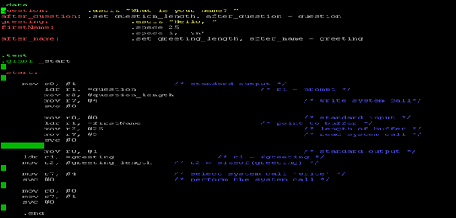
"helloName.s"

Slide 11
Summary
The ARM6 processor in the Raspberry Pi, running Raspbian, can make system calls to access services of the operating system. Input and output are very easy, as they operate a line at a time, much like Console.ReadLine() and Console.WriteLine() in C#.

